Slide 1
ECE5578 Multimedia Communication Final Project Report Spring 2020
By Matthew Kayrish

Slide 2
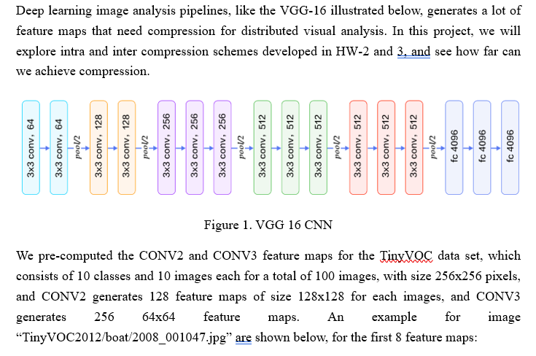
Final Project: VBB Convolutional Feature Map Compression Introduction

Slide 3
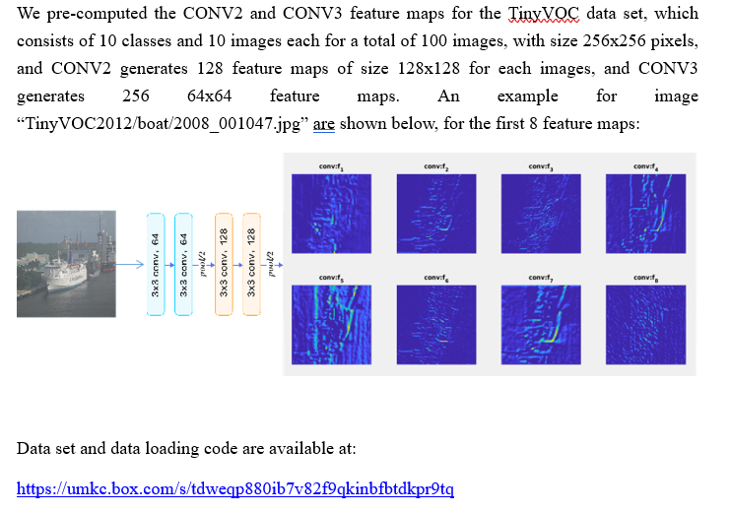
Final Project: VBB Convolutional Feature Map Compression Introduction

Slide 4

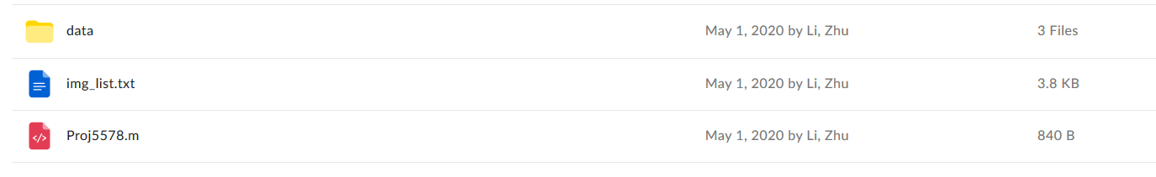
Final Project: VBB Convolutional Feature Map Compression Introduction

Slide 5
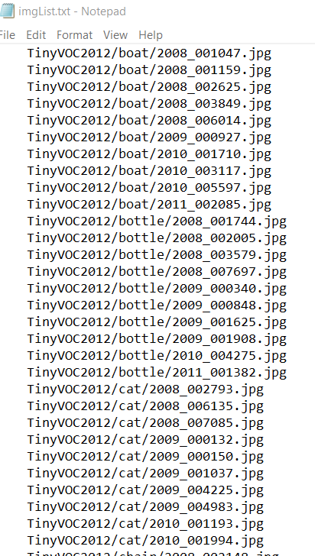
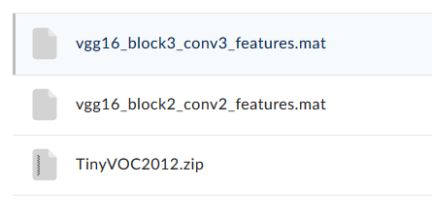
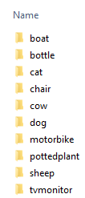
Final Project: VBB Convolutional Feature Map Compression Introduction
MATLAB Data File
MATLAB Data File
10 Classes
- 10 Images per Class
- 100 Images Total

Slide 6
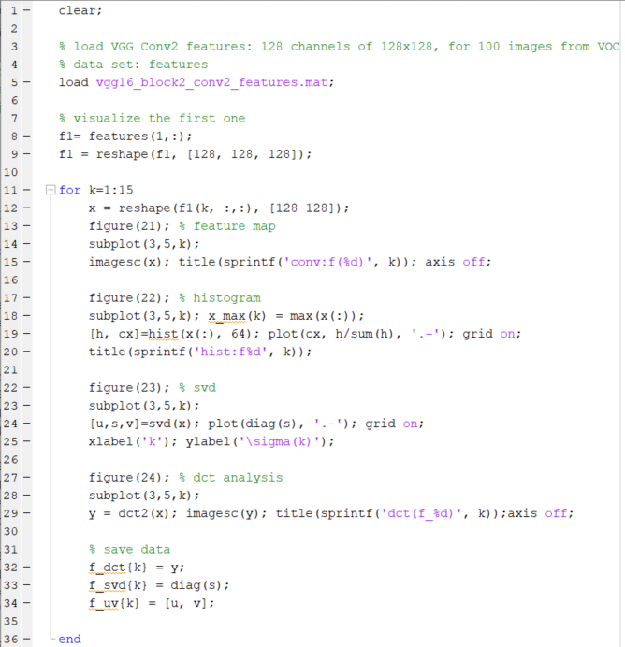
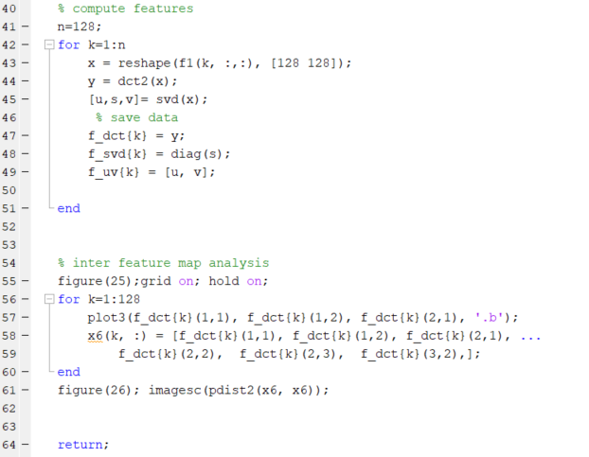
Final Project: VBB Convolutional Feature Map Compression Introduction
This File Will Get Ingested into a Reworked Final Script.

Slide 7
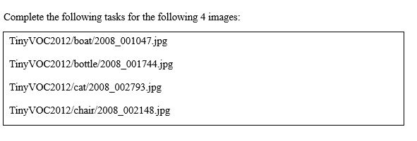
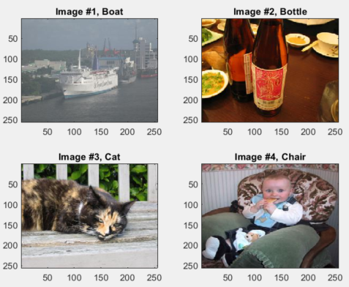
Final Project: VBB Convolutional Feature Map Compression: The Task

Slide 8
Final Project: VBB Convolutional Feature Map Compression: The Task
INTRA Coding [20 pts]
INTRA Compression [30 pts]
INTER Prediction [50 pts]

Slide 9

Final Project: VBB Convolutional Feature Map Compression: The Task
Offset 1
Offset 11
Offset 21
Offset 31

Slide 10
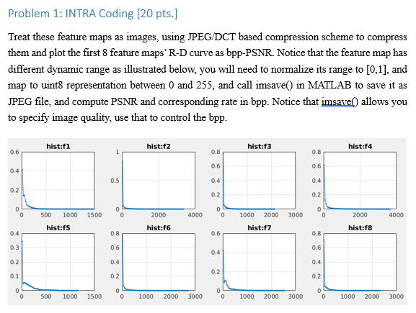
Final Project: VBB Convolutional Feature Map Compression: Problem 1

Slide 11
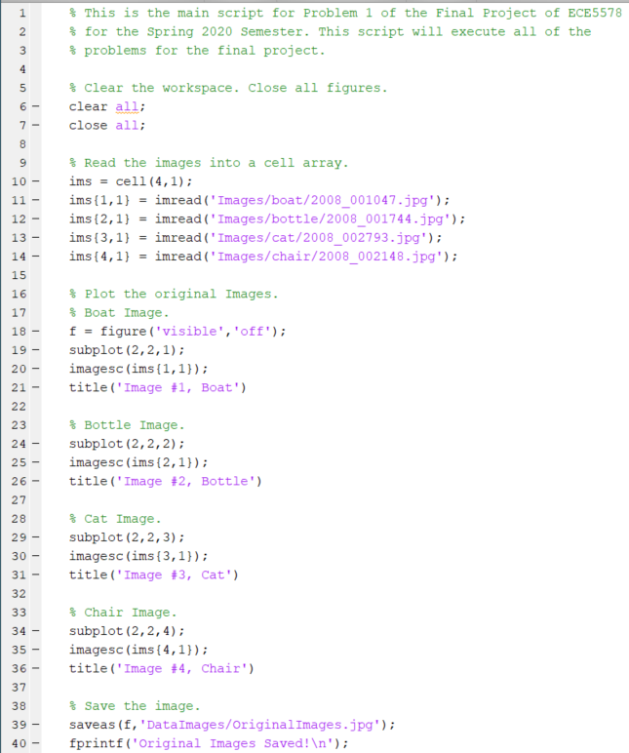
Final Project: VBB Convolutional Feature Map Compression: Problem 1
Clear the workspace.
Read the Images.
Plot the Images.
Save the Images.

Slide 12
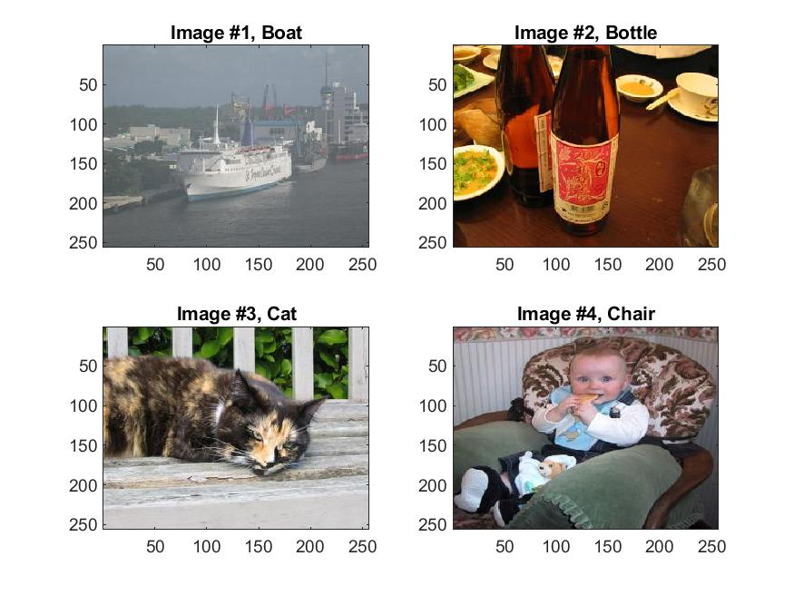
Final Project: VBB Convolutional Feature Map Compression: Problem 1

Slide 13
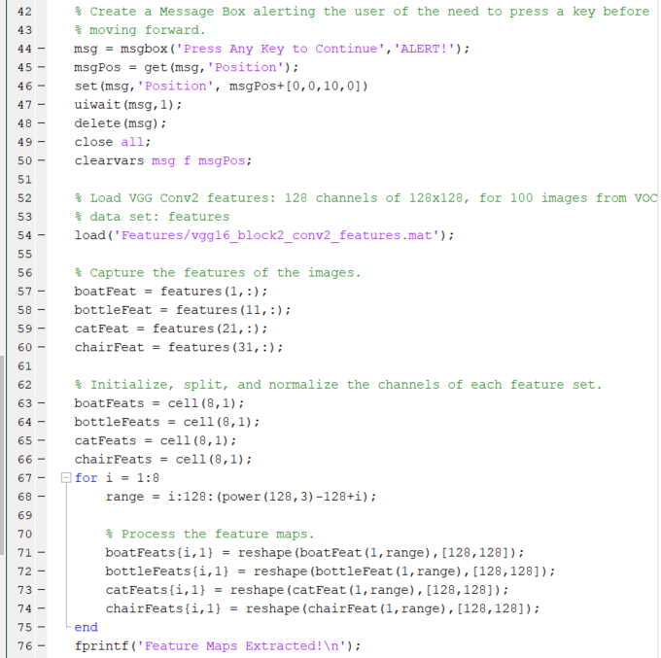
Final Project: VBB Convolutional Feature Map Compression: Problem 1
Message Box.
Load Feature Set.
Extract the associated feature maps
Corresponding to the images.
Initialize, Split, and Reshape the Feature
Maps for the Associated Images.

Slide 14
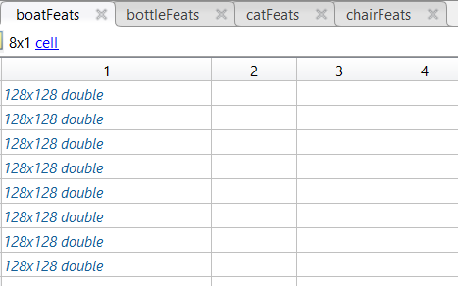
Final Project: VBB Convolutional Feature Map Compression: Problem 1
Extract and reshape 8 128x128 Feature Maps for Each Image.

Slide 15
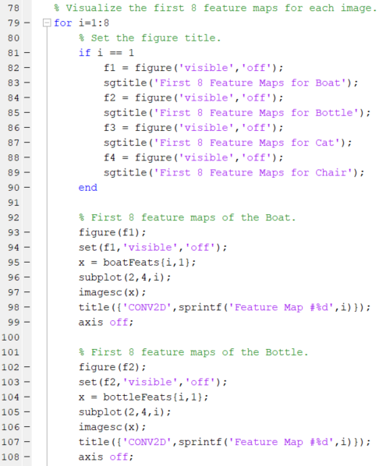
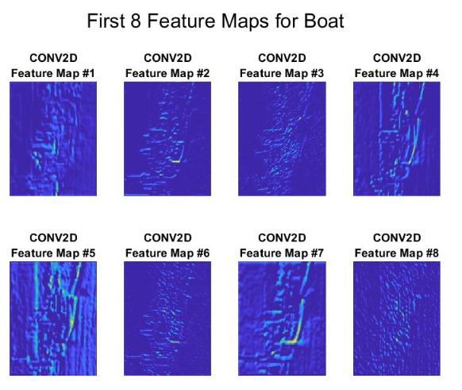
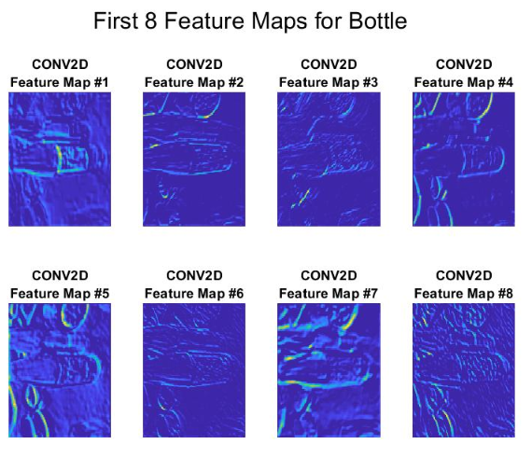
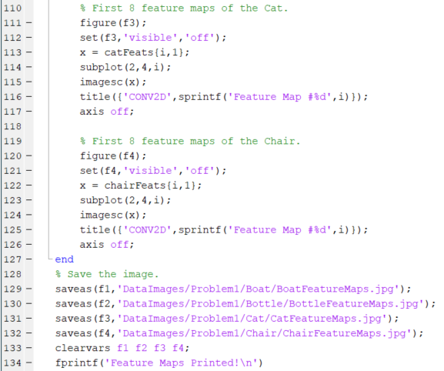
Final Project: VBB Convolutional Feature Map Compression: Problem 1

Slide 16
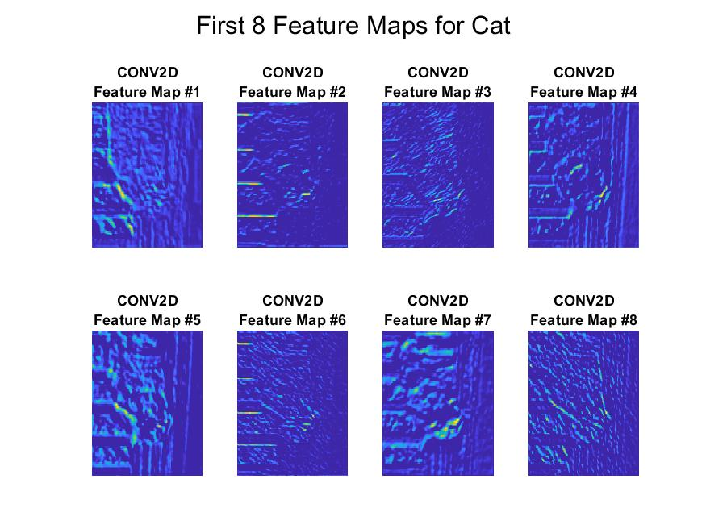
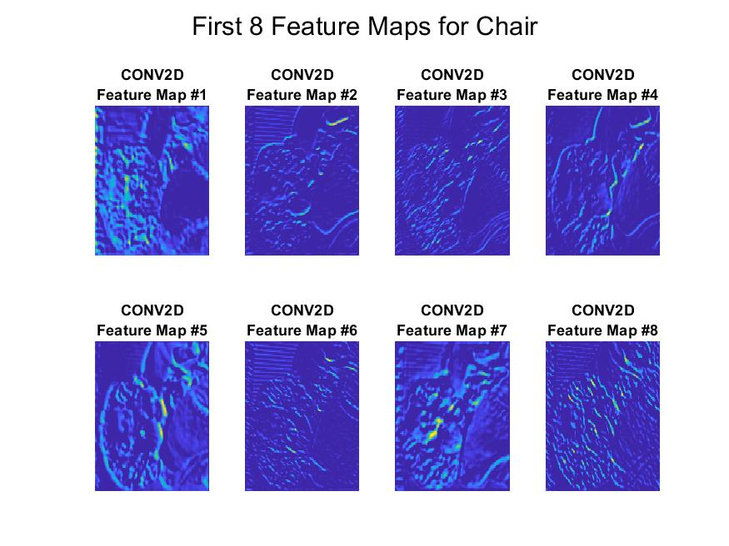
Final Project: VBB Convolutional Feature Map Compression: Problem 1

Slide 17
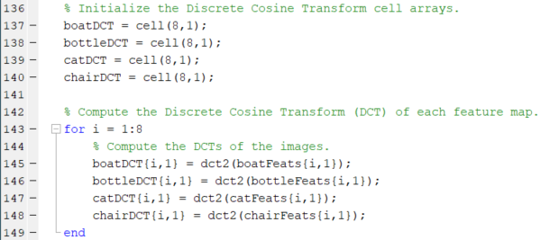
Final Project: VBB Convolutional Feature Map Compression: Problem 1
Initialize and Compute the
Discrete Cosine Transform (DCT).

Slide 18
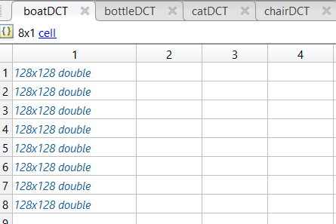
Final Project: VBB Convolutional Feature Map Compression: Problem 1

Slide 19
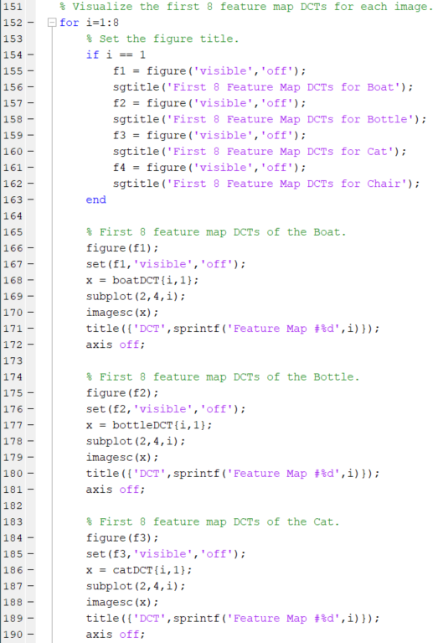
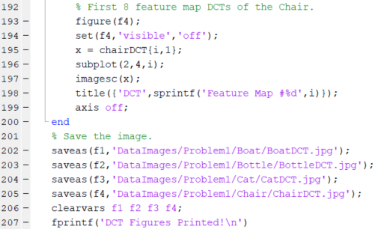
Final Project: VBB Convolutional Feature Map Compression: Problem 1
Set the Image Title
Plot the Feature Maps
Plot Each Feature Map
Save Each Feature Map as a JPEG.

Slide 20
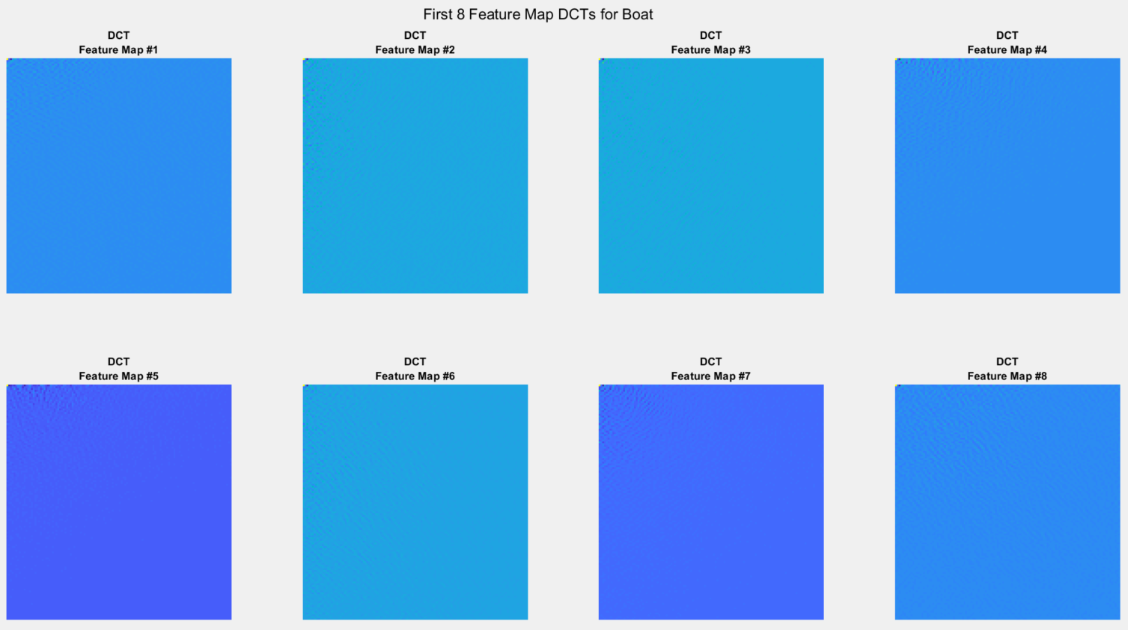
Final Project: VBB Convolutional Feature Map Compression: Problem 1

Slide 21
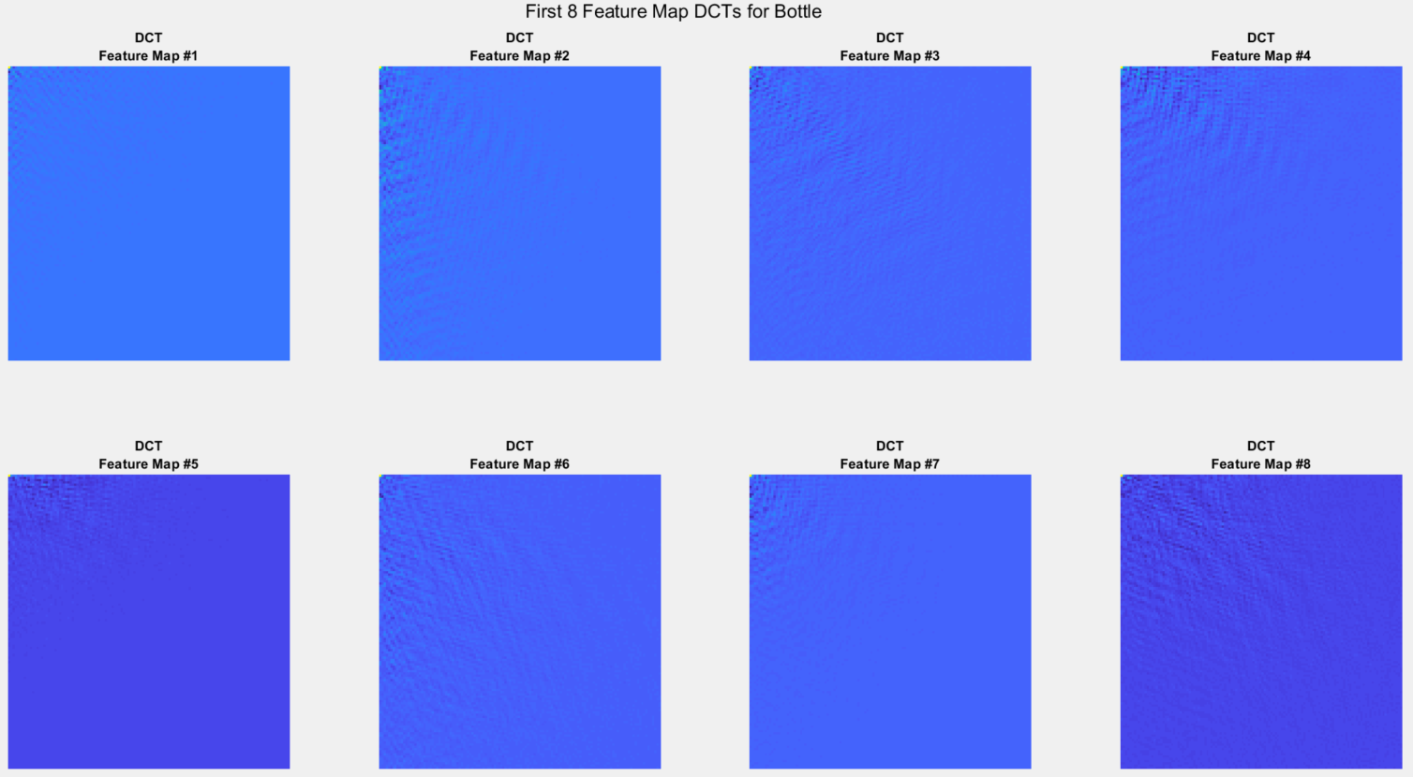
Final Project: VBB Convolutional Feature Map Compression: Problem 1

Slide 22
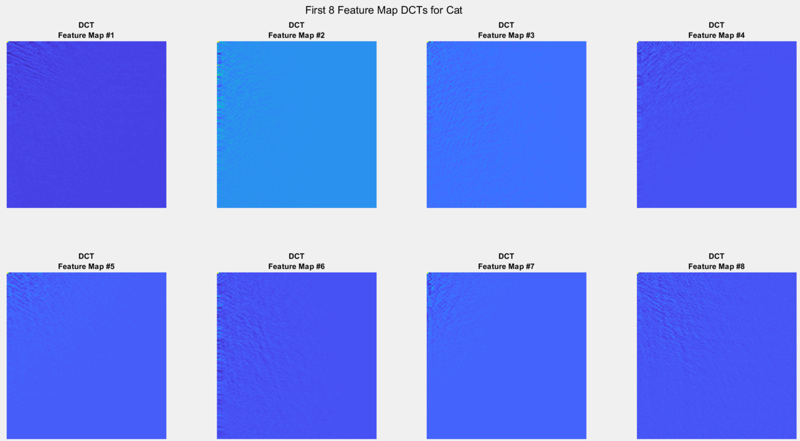
Final Project: VBB Convolutional Feature Map Compression: Problem 1

Slide 23
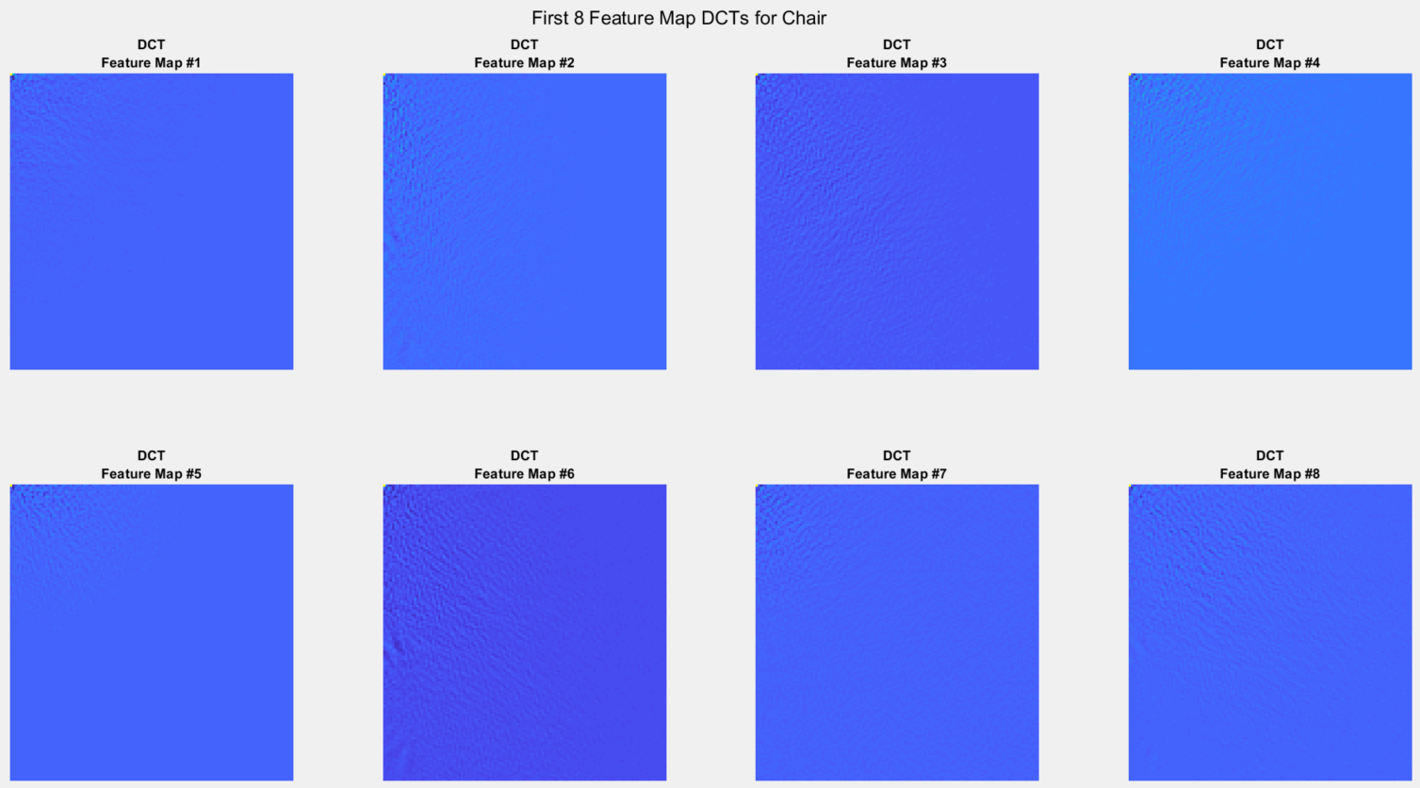
Final Project: VBB Convolutional Feature Map Compression: Problem 1

Slide 24
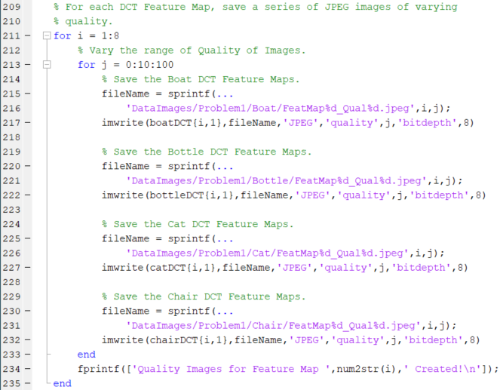
Final Project: VBB Convolutional Feature Map Compression: Problem 1
Save the Images as JPEGs of varying
Quality.

Slide 25
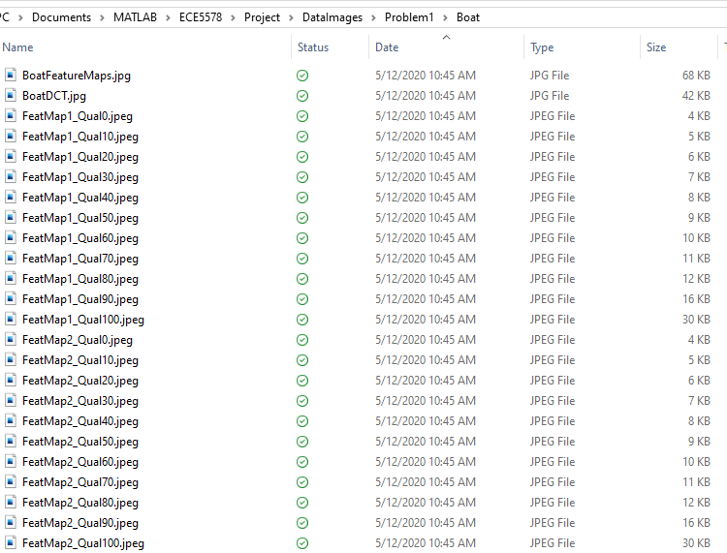
Final Project: VBB Convolutional Feature Map Compression: Problem 1
NOTICE: as the quality increases, the size of the file increases.
This indicates that more the save type, the compression, and
Quantization used are more ‘lossless’. Therefore, more data
Is required to save the full image.

Slide 26





Final Project: VBB Convolutional Feature Map Compression: Problem 1

Slide 27
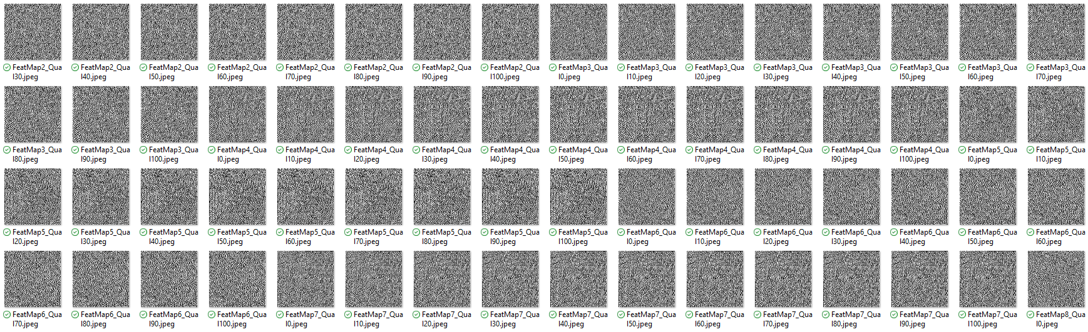
Final Project: VBB Convolutional Feature Map Compression: Problem 1
BOAT: JPEG DCT COMPRESSED FEATURE MAPS OF VARIOUS QUALITY.

Slide 28
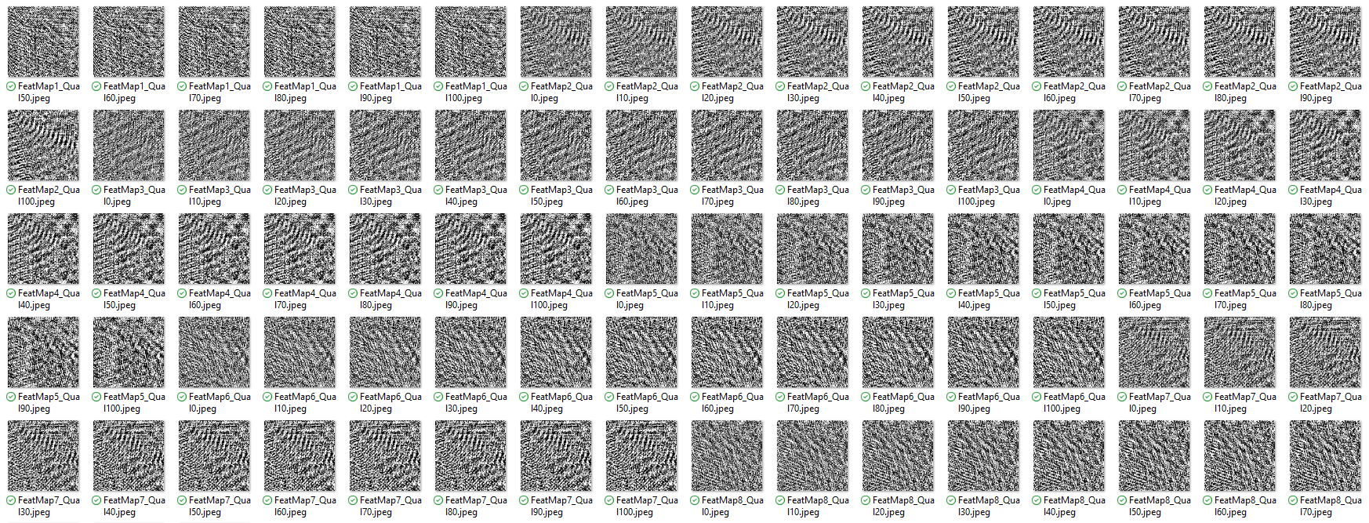
Final Project: VBB Convolutional Feature Map Compression: Problem 1
BOTTLE: JPEG DCT COMPRESSED FEATURE MAPS OF VARIOUS QUALITY.

Slide 29
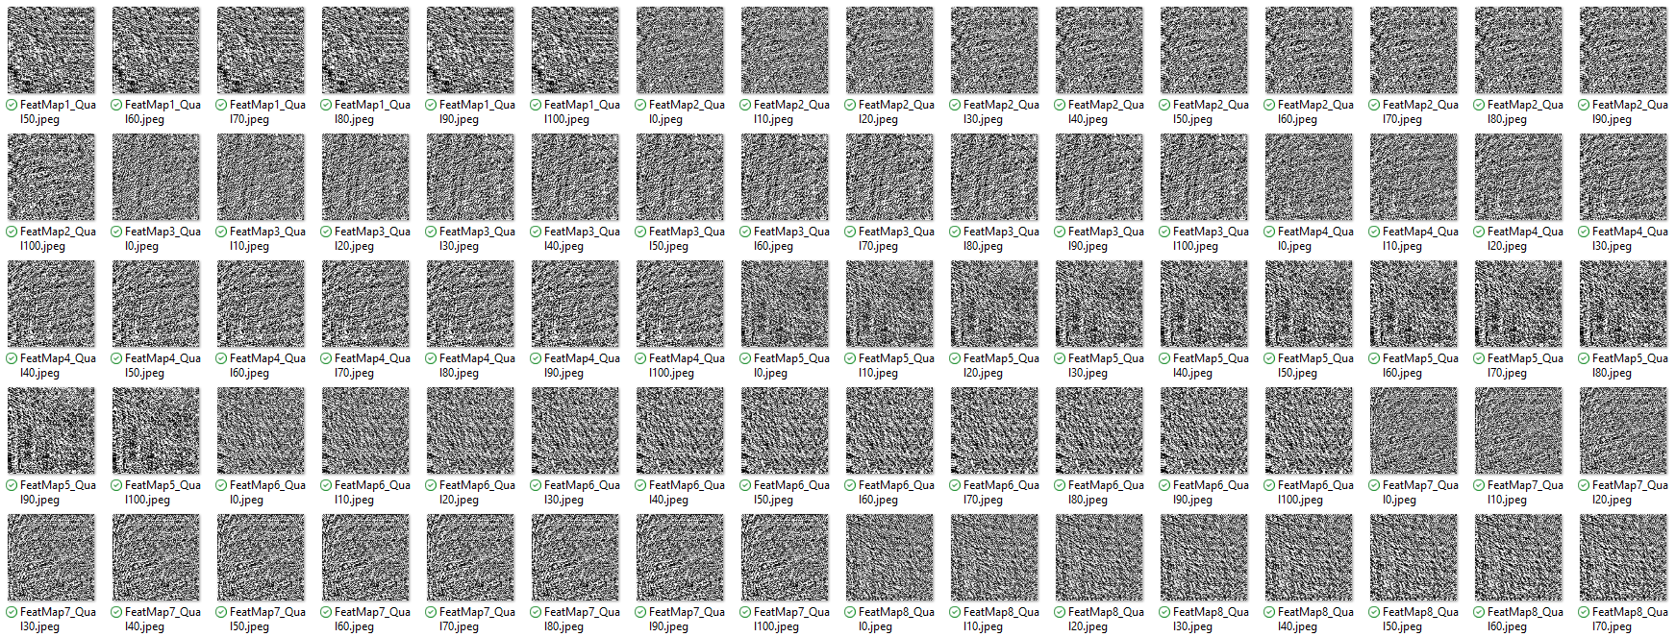
Final Project: VBB Convolutional Feature Map Compression: Problem 1
CAT: JPEG DCT COMPRESSED FEATURE MAPS OF VARIOUS QUALITY.

Slide 30
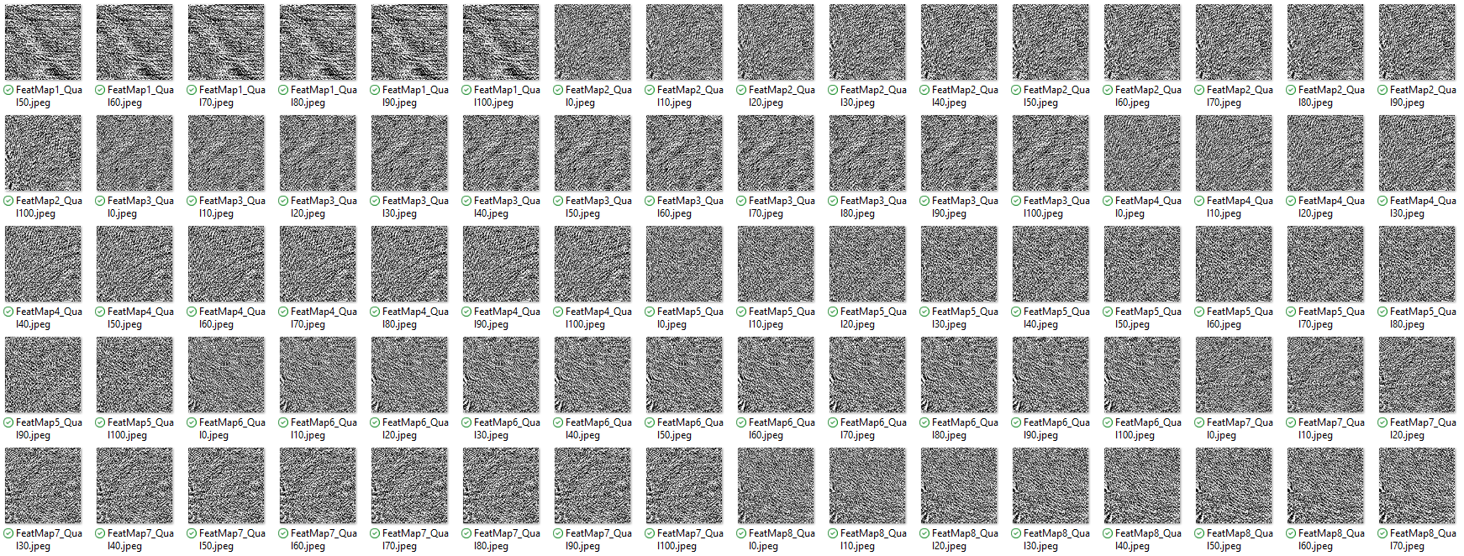
Final Project: VBB Convolutional Feature Map Compression: Problem 1
CHAIR: JPEG DCT COMPRESSED FEATURE MAPS OF VARIOUS QUALITY.

Slide 31
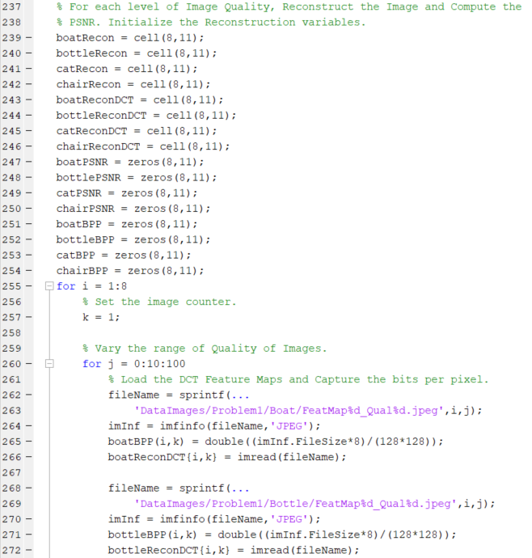
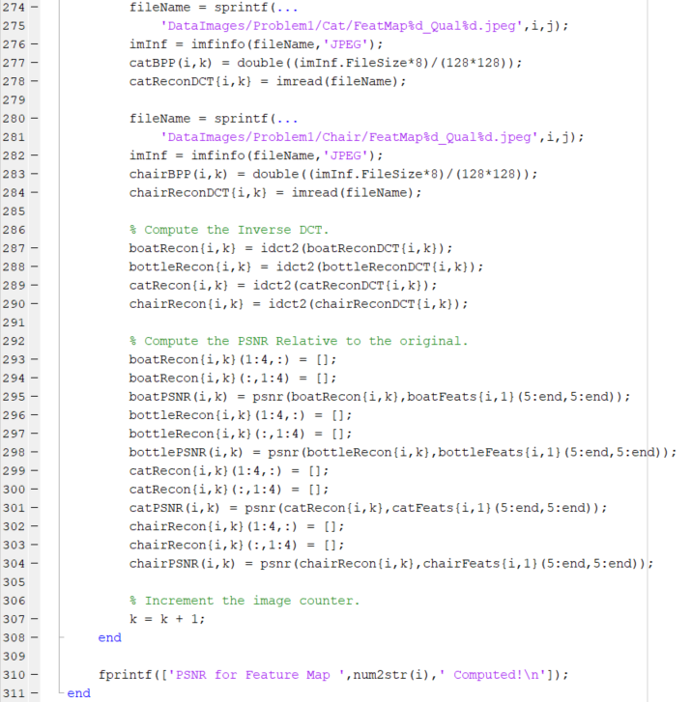
Final Project: Problem 1
Initialize the Reconstructed Feature Maps, the Reconstructed
DCT Features, the PSNRs and the Bits Per Pixel Variables.
Read the JPEG files
Capture file info
Compute the Bits Per Pixel (BPP)
Compute the Inverse DCT of each Feature Map.
Compute the PSNR.

Slide 32
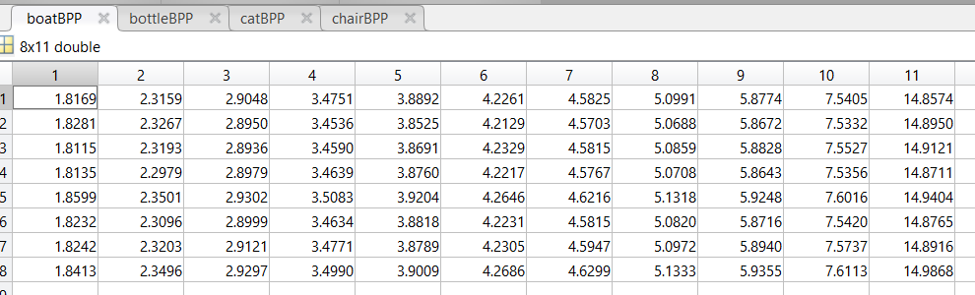
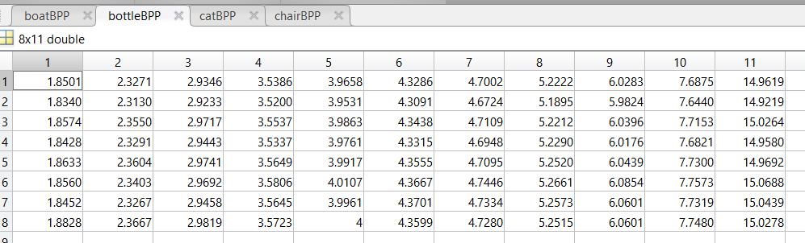
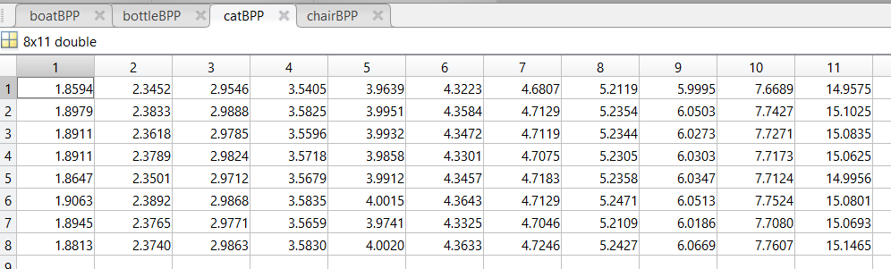
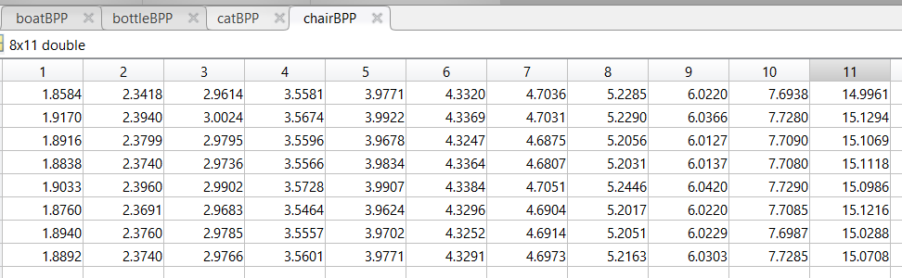
Final Project: Problem 1
Bits Per Pixel (BPP)
FEATURE MAPS 1 thru 8
MATLAB JPEG COMPRESSION QUALITY 0 thru 100 , incremented by 10.

Slide 33
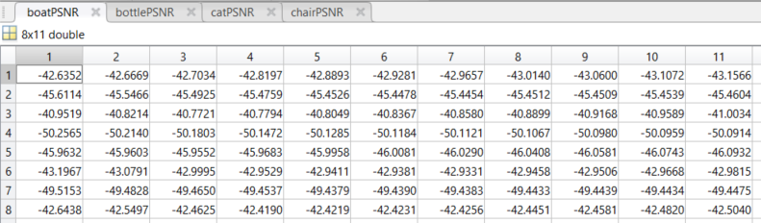
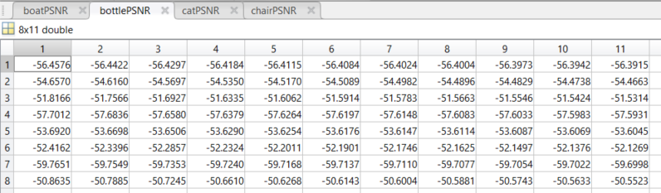
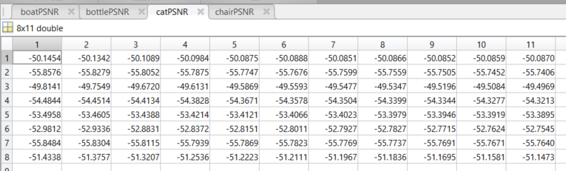
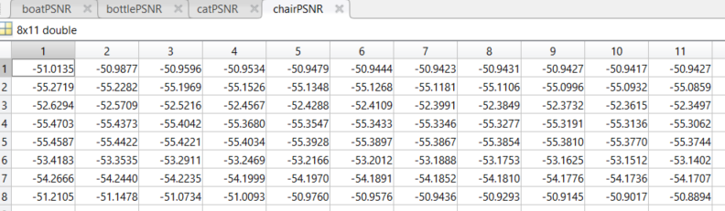
Final Project: Problem 1
Signal to Noise Ratio (PSNR)
FEATURE MAPS 1 thru 8
MATLAB JPEG COMPRESSION QUALITY 0 thru 100 , incremented by 10.

Slide 34
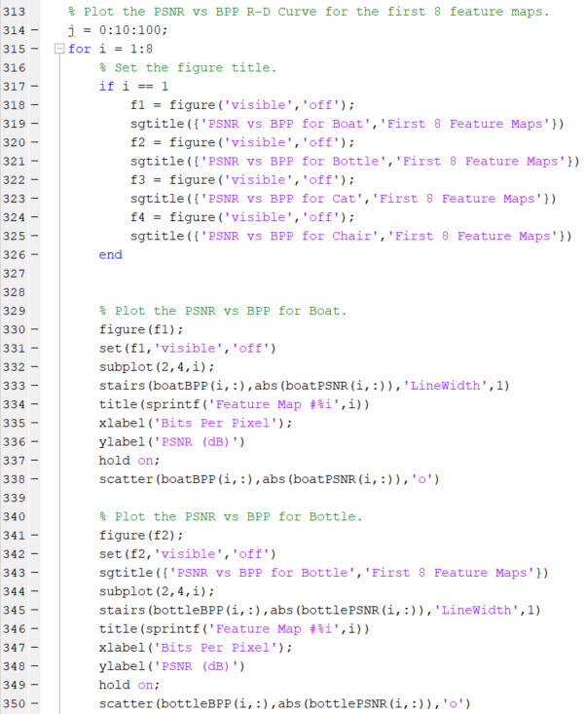
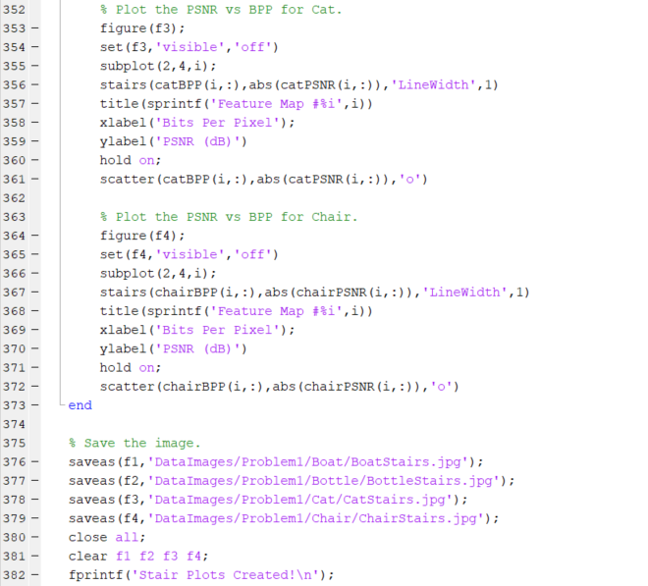
Final Project: Problem 1
Set the figure title.
Plot the Stair Plots for each feature map.
Save the images to JPEG files.

Slide 35
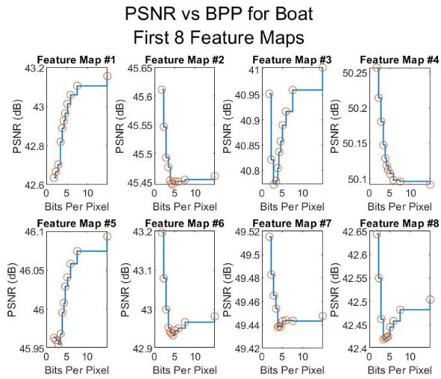
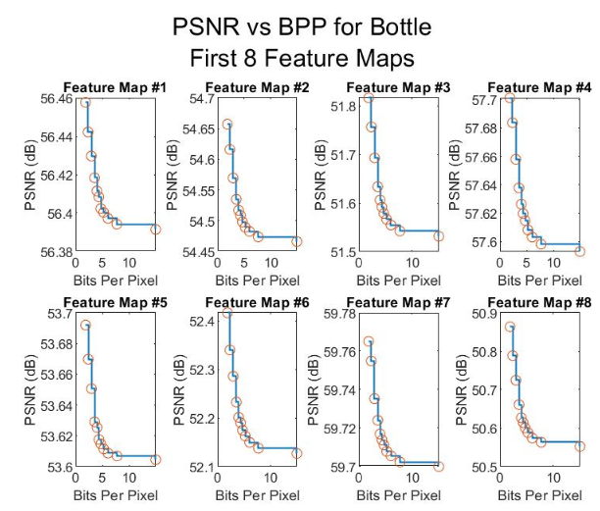
Final Project: Problem 1

Slide 36
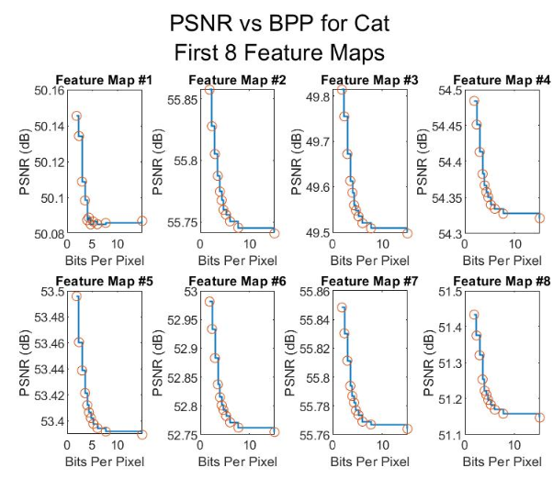

Final Project: Problem 1

Slide 37


Final Project: Problem 1
Set the figure title.
Plot the Stair Plots for each feature map.
Save the images to JPEG files.

Slide 38

Final Project: Problem 1

Slide 39

Final Project: Problem 1

Slide 40

Final Project: Problem 1

Slide 41

Final Project: Problem 1

Slide 42

Final Project: Problem 1

Slide 43

Final Project: Problem 1

Slide 44

Final Project: Problem 1

Slide 45

Final Project: Problem 1

Slide 46

Final Project: Problem 1

Slide 47

Final Project: Problem 1

Slide 48

Final Project: Problem 1

Slide 49

Final Project: Problem 1

Slide 50

Final Project: Problem 1

Slide 51

Final Project: Problem 1

Slide 52

Final Project: Problem 1

Slide 53

Final Project: Problem 1

Slide 54

Final Project: Problem 1

Slide 55

Final Project: Problem 1

Slide 56

Final Project: Problem 1

Slide 57

Final Project: Problem 1

Slide 58

Final Project: Problem 1

Slide 59

Final Project: Problem 1

Slide 60

Final Project: Problem 1

Slide 61

Final Project: Problem 1

Slide 62

Final Project: Problem 1

Slide 63

Final Project: Problem 1

Slide 64

Final Project: Problem 1

Slide 65

Final Project: Problem 1

Slide 66

Final Project: Problem 1

Slide 67

Final Project: Problem 1

Slide 68

Final Project: Problem 1

Slide 69

Final Project: Problem 1

Slide 70

Final Project: Problem 1

Slide 71
Final Project: Problem 1 Conclusion
Using JPEG Compression provides an effective means for reducing the size without sacrificing the quality.
As the quality of the image saved in MATLAB decreased, the PSNR also decreased, but by very little amounts.
The difference in PSNR vs Quality was nearly negligible.
As Quality measured in BPP, very little increase in PSNR was observed.
JPEG plus DCT Compression is a VERY EFFECTIVE means fore reducing the data requirement without much sacrifice in quality.

Slide 72

Final Project: VBB Convolutional Feature Map Compression: Problem 2

Slide 73

Final Project: VBB Convolutional Feature Map Compression: Problem 2
Clear the workspace.
Load the Features.
Extract the Features.
Reshape and rescale the features to range
From 0 – 255.
Initialize the Spatial Filter.

Slide 74


Final Project: Problem 2
Filter the Feature Maps.
Initialize the histograms, Entropy Values,
Quantization Levels, and bin boundaries.
If Quantization Level is Zero, compute the
‘No Quantization’ histogram and entropy of the
Lossless feature map.
If Quantization Level is not Zero, call the function
‘imQuantCalc’ to compute the histogram and
entropy of the Lossless feature map.

Slide 75







Final Project: Problem 2
0-255
By ‘8’
0-255
0-255
0-255
By ‘2’
0-255
By ‘4’
0-255
By ‘16’

Slide 76

Final Project: Problem 2
Histograms/PMF for Each Feature Map and Quantization Level.
Largely Centered at Zero.

Slide 77




Final Project: Problem 2
Entropy for Each Feature Map and Quantization Level.
Feature Map
Quantization: None 1 2 4 8 16

Slide 78

Final Project: Problem 2
Compute the Histogram and Entropy of
The quantized feature map.
Quantize the Feature Map.
Establish the Histogram Bin Boundaries.
Compute the Histogram and the Probability
Mass Function.
Compute the Entropy.

Slide 79

Final Project: Problem 2
Compute the Entropy of the quantized
feature map.
Compute the Entropy of the Probability
Mass Function.

Slide 80



Final Project: Problem 2
Plot the histograms.
Update the Step Size, Update the Bounds, Plot the Histogram.

Slide 81

Final Project: Problem 2

Slide 82

Final Project: Problem 2

Slide 83

Final Project: Problem 2

Slide 84

Final Project: Problem 2

Slide 85

Final Project: Problem 2

Slide 86

Final Project: Problem 2

Slide 87

Final Project: Problem 2

Slide 88

Final Project: Problem 2

Slide 89

Final Project: Problem 2

Slide 90

Final Project: Problem 2

Slide 91

Final Project: Problem 2

Slide 92

Final Project: Problem 2

Slide 93

Final Project: Problem 2

Slide 94

Final Project: Problem 2

Slide 95

Final Project: Problem 2

Slide 96

Final Project: Problem 2

Slide 97

Final Project: Problem 2

Slide 98

Final Project: Problem 2

Slide 99

Final Project: Problem 2

Slide 100

Final Project: Problem 2

Slide 101

Final Project: Problem 2

Slide 102

Final Project: Problem 2

Slide 103

Final Project: Problem 2

Slide 104

Final Project: Problem 2

Slide 105

Final Project: Problem 2

Slide 106

Final Project: Problem 2

Slide 107

Final Project: Problem 2

Slide 108

Final Project: Problem 2

Slide 109

Final Project: Problem 2

Slide 110

Final Project: Problem 2

Slide 111

Final Project: Problem 2

Slide 112

Final Project: Problem 2

Slide 113
Final Project: Problem 2 Conclusion
As the Quantization level increases, the Entropy will continuously reduce. This is because the data is more concentrated around zero, and consequently, less information is carried per bit.
The feature maps are largely concentrated around zero. As observed in Homework 2, the quantization will yield a slight performance degradation with a significant gain in compression.
Using Quantization will yield a slight performance degradation with a significant increase in compression. Combining this with the DCT may increase the compression with little degradation in quality even further.

Slide 114

Final Project: VBB Convolutional Feature Map Compression: Problem 3
DISCLAIMER: As Problem 3 relies very heavily on the scheme developed in Homework 3, some
Of the slides developed for that assignment are directly reused in this Final Project Report. Those
Slides have been appropriately labeled. Some of the data is not identical, but the principles still
Apply, and therefore are appropriate for use in this Final Report.

Slide 115

Final Project: Problem 3
Clear the Workspace.
Load the Features.
Extract and Reshape
the Features.

Slide 116

Final Project: Problem 3
Initialize the Best Fit Frame and MSE.
Function call to ‘estMotion’. Plot Off.
Loop: Call Motion Estimation to
Determine the best fit reference
frame.
Function call to ‘estMotion’. Plot On.

Slide 117

Final Project: Problem 3
Could be set to 4x4 or 8x8 blocks.
Parameter Initialization
For Final Project, Block was set to ‘4’.
Establish the appropriate ‘y’ range.
Establish the appropriate ‘x’ range.
Parse Block by selected size.
DISCLAIMER: This Slide is Reused from Homework 3.

Slide 118


Final Project: Problem 3
For Final Project, Block Size was set to ‘4’.
DISCLAIMER: This Slide is Reused from Homework 3.

Slide 119

Final Project: Problem 3
For Final Project, ‘pel’ was set to 0.5.
Custom Function ‘bilinearInterpolation’
Custom Function ‘getBlkMotion’
DISCLAIMER: This Slide is Reused from Homework 3.

Slide 120

Final Project: Problem 3
DISCLAIMER: This Slide is Reused from Homework 3.

Slide 121



Final Project: Problem 3
DISCLAIMER: This Slide is Reused from Homework 3.
Input Image Becomes…
…an interpolated output image
with increased dimensions.

Slide 122

Final Project: Problem 3
DISCLAIMER: This Slide is Reused from Homework 3.
Interpolate each block if needed.

Slide 123

Final Project: Problem 3
DISCLAIMER: This Slide is Reused from Homework 3.
Initialize parameters.
Compute the residual block
Compute the Mean Absolute
Deviation for each block.

Slide 124

Final Project: Problem 3
DISCLAIMER: This Slide is Reused from Homework 3.

Slide 125


Final Project: Problem 3
DISCLAIMER: This Slide is Reused from Homework 3.
Generate the MAD for each block. Infinity indicates the MAD
could not be calculated and must be removed. You want the
smallest MAD.

Slide 126


Final Project: Problem 3
DISCLAIMER: This Slide is Reused from Homework 3.
Residual Blocks
Motion Vectors

Slide 127




Final Project: Problem 3
DISCLAIMER: This Slide is Reused from Homework 3.
Cell Array of Motion Vectors
Cell Array of Residual Blocks

Slide 128

Final Project: Problem 3
DISCLAIMER: This Slide is Reused from Homework 3.
Adjust the block size for different pel values.
Determine the ranges for the ‘x’ and ‘y’ coordinates.
Reassemble the residual image.
Extract motion vectors for the quiver plot.

Slide 129


Final Project: Problem 3
DISCLAIMER: This Slide is Reused from Homework 3.
Locations
Magnitudes

Slide 130



Final Project: Problem 3
A Plot Feature has been added to ‘estMotion’
As it is applicable to the Final Project. If the
Reference frame is the best fit, recall ‘estMotion’
With the plot feature enabled.

Slide 131


Final Project: Problem 3

Slide 132



Final Project: Problem 3

Slide 133
Final Project: Problem 3
Plot Feature Enabled.

Slide 134
Final Project: Problem 3
Motion Estimation Results for Boat.

Slide 135


Final Project: Problem 3
Motion Estimation Results for Boat.

Slide 136


Final Project: Problem 3
Motion Estimation Results for Boat.

Slide 137


Final Project: Problem 3
Motion Estimation Results for Boat.

Slide 138


Final Project: Problem 3
Motion Estimation Results for Boat.

Slide 139


Final Project: Problem 3
Motion Estimation Results for Boat.

Slide 140


Final Project: Problem 3
Motion Estimation Results for Boat.

Slide 141


Final Project: Problem 3
Motion Estimation Results for Boat.

Slide 142


Final Project: Problem 3
Motion Estimation Results for Boat.

Slide 143


Final Project: Problem 3
Motion Estimation Results for Boat.

Slide 144


Final Project: Problem 3
Motion Estimation Results for Boat.

Slide 145


Final Project: Problem 3
Motion Estimation Results for Boat.

Slide 146


Final Project: Problem 3
Motion Estimation Results for Boat.

Slide 147


Final Project: Problem 3
Motion Estimation Results for Boat.

Slide 148


Final Project: Problem 3
Motion Estimation Results for Boat.

Slide 149



Final Project: Problem 3

Slide 150


Final Project: Problem 3
Motion Estimation Results for Bottle.

Slide 151


Final Project: Problem 3
Motion Estimation Results for Bottle.

Slide 152


Final Project: Problem 3
Motion Estimation Results for Bottle.

Slide 153


Final Project: Problem 3
Motion Estimation Results for Bottle.

Slide 154


Final Project: Problem 3
Motion Estimation Results for Bottle.

Slide 155


Final Project: Problem 3
Motion Estimation Results for Bottle.

Slide 156


Final Project: Problem 3
Motion Estimation Results for Bottle.

Slide 157


Final Project: Problem 3
Motion Estimation Results for Bottle.

Slide 158


Final Project: Problem 3
Motion Estimation Results for Bottle.

Slide 159


Final Project: Problem 3
Motion Estimation Results for Bottle.

Slide 160


Final Project: Problem 3
Motion Estimation Results for Bottle.

Slide 161


Final Project: Problem 3
Motion Estimation Results for Bottle.

Slide 162


Final Project: Problem 3
Motion Estimation Results for Bottle.

Slide 163


Final Project: Problem 3
Motion Estimation Results for Bottle.

Slide 164


Final Project: Problem 3
Motion Estimation Results for Bottle.

Slide 165



Final Project: Problem 3

Slide 166


Final Project: Problem 3
Motion Estimation Results for Cat.

Slide 167


Final Project: Problem 3
Motion Estimation Results for Cat.

Slide 168


Final Project: Problem 3
Motion Estimation Results for Cat.

Slide 169


Final Project: Problem 3
Motion Estimation Results for Cat.

Slide 170


Final Project: Problem 3
Motion Estimation Results for Cat.

Slide 171


Final Project: Problem 3
Motion Estimation Results for Cat.

Slide 172


Final Project: Problem 3
Motion Estimation Results for Cat.

Slide 173


Final Project: Problem 3
Motion Estimation Results for Cat.

Slide 174


Final Project: Problem 3
Motion Estimation Results for Cat.

Slide 175


Final Project: Problem 3
Motion Estimation Results for Cat.

Slide 176


Final Project: Problem 3
Motion Estimation Results for Cat.

Slide 177


Final Project: Problem 3
Motion Estimation Results for Cat.

Slide 178


Final Project: Problem 3
Motion Estimation Results for Cat.

Slide 179


Final Project: Problem 3
Motion Estimation Results for Cat.

Slide 180


Final Project: Problem 3
Motion Estimation Results for Cat.

Slide 181



Final Project: Problem 3

Slide 182


Final Project: Problem 3
Motion Estimation Results for Chair.

Slide 183


Final Project: Problem 3
Motion Estimation Results for Chair.

Slide 184


Final Project: Problem 3
Motion Estimation Results for Chair.

Slide 185


Final Project: Problem 3
Motion Estimation Results for Chair.

Slide 186


Final Project: Problem 3
Motion Estimation Results for Chair.

Slide 187


Final Project: Problem 3
Motion Estimation Results for Chair.

Slide 188


Final Project: Problem 3
Motion Estimation Results for Chair.

Slide 189


Final Project: Problem 3
Motion Estimation Results for Chair.

Slide 190


Final Project: Problem 3
Motion Estimation Results for Chair.

Slide 191


Final Project: Problem 3
Motion Estimation Results for Chair.

Slide 192


Final Project: Problem 3
Motion Estimation Results for Chair.

Slide 193


Final Project: Problem 3
Motion Estimation Results for Chair.

Slide 194


Final Project: Problem 3
Motion Estimation Results for Chair.

Slide 195


Final Project: Problem 3
Motion Estimation Results for Chair.

Slide 196


Final Project: Problem 3
Motion Estimation Results for Chair.

Slide 197

Final Project: Problem 3
Save the Data.

Slide 198
Final Project: Problem 3 Conclusion
Motion estimation will identify the most similar features at various levels as they become more apparent.
Using motion estimation, new feature maps may be readily generated from previous feature maps without the need to transmit entire frames.
Motion estimation provides a means of transmitting video using much less data and much less bandwidth.
Motion Estimation provides a means for transmitting video and frame data using little bandwidth, thus increasing the transmission rate, and reducing footprint.

